Slide 1



Capstone
Project
Novia:
No Violence App Report
Group ID
B21-CAP0213
Notes:
Hello, welcome to our presentation! Today, we are from the B21-CAP0213 group will present our Capstone Project for Bangkit Academy 2021 named Novia: No Violence App Report.

Slide 2









Meet our
members
Tassamu Akhsan N.
M1481712 | Machine Learning
Salomo Hutapea
A0080921 | Mobile Development
Farhan Deristianto P.
A0050493 | Mobile Development
Achmad Rifki R. B.
C2001975 | Cloud Computing
Marissa Leviani
C0050529 | Cloud Computing
Amyra Sarah Luthvia
M0050535 | Machine Learning
Notes:
Before we start, we will introduce you to the people behind this project. Our super team consists of 6 students, including 2 Android Developers, 2 Machine Learning Engineers, and 2 Cloud Engineers. Two of them are women (including me), which is related to the theme of our project. So, what exactly is our project?

Slide 3
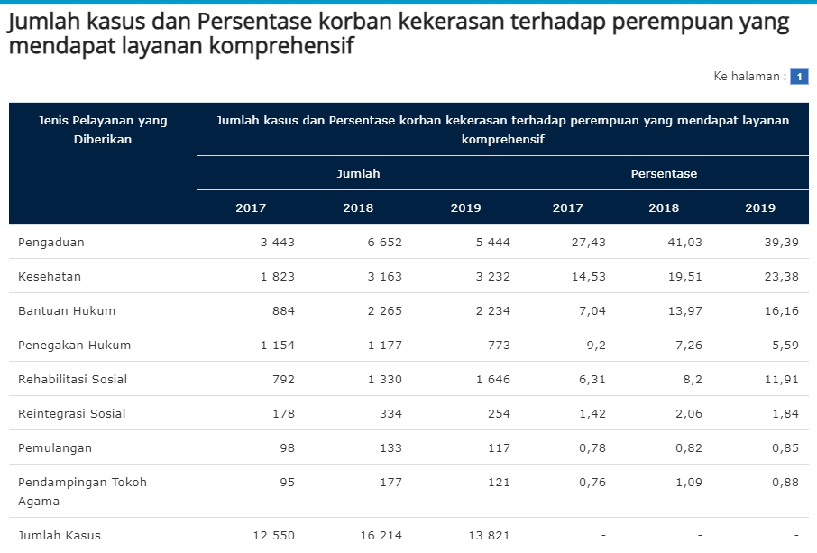
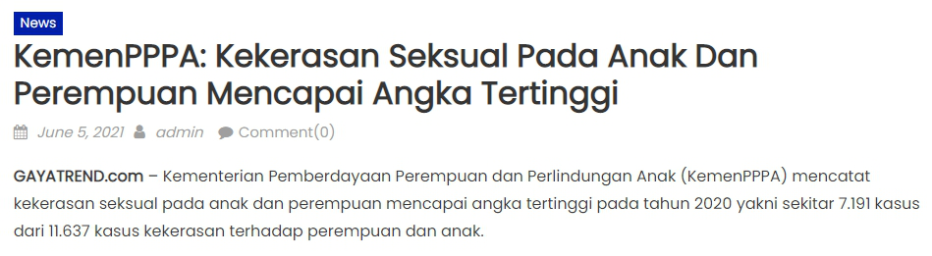
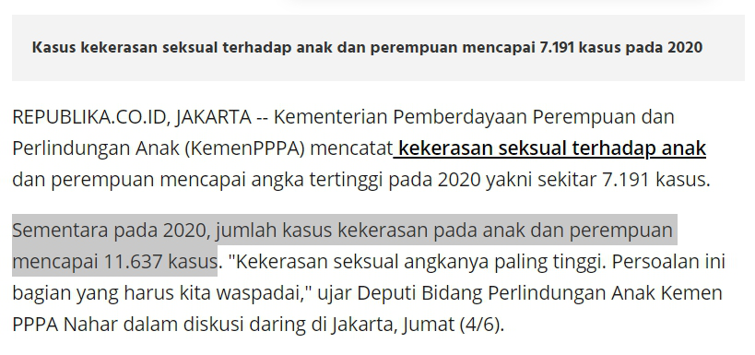
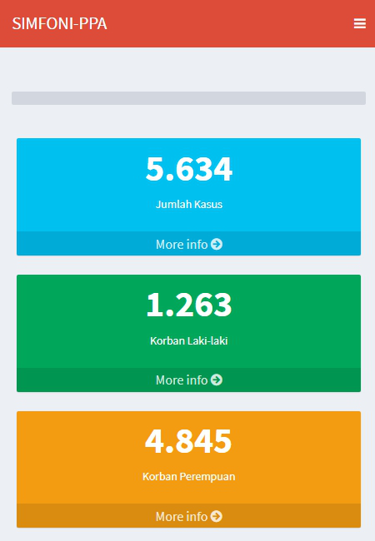
in Indonesia...
11.637
total cases of violence against
women and children in 2020
Percentage of victims of violence who receive right treatment
Source: Badan Pusat Statistik
Source: Gayatrend.com
7.191
cases or 6 out of 10 women and child experience sexual violence
Total cases of violence to women and child;
Last update: June 7 2021, 12.45 PM
Source: SIMFONI-Kementerian PPPA
Source: REPUBLIKA
Source: Ministry of Women’s Empowerment and Child Protection
of the Republic of Indonesia (Kementerian PPPA)
Notes:
Have you ever heard that in 2020, there are more than 11.000 cases of violence against women and children in Indonesia. It means that 6 out of 10 women and child experience sexual violence. This data has only been obtained from the Ministry of Women's Empowerment and Child Protection or Kementerian PPPA. Meanwhile in Indonesia, there are other authorities that also oversee the issue of women & children, such as the Komnas Perempuan and KPAI which may record a different number of cases.

Slide 4

“
The process of reporting from the victims of violence
still took a long time to
filter,
prioritize,
take action.
Ciput Purwianti
from Ministry of Women’s Empowerment and Child Protection of Indonesia
(Kementerian PPPA)
Notes:
From the Capstone Theme Presentation delivered by Mrs. Ciput Purwianti from Kementerian PPPA last month, we noted some conclusions that the process of case reporting still takes a long time to filter, prioritize and take action. That's why they from the ministry are still having a hard time serving all cases and victims with the right and proper handling. Moreover, Indonesia has a very wide geographical area.

Slide 5
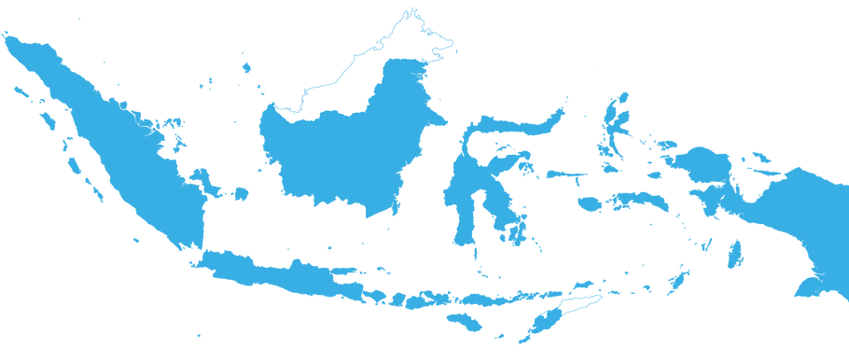



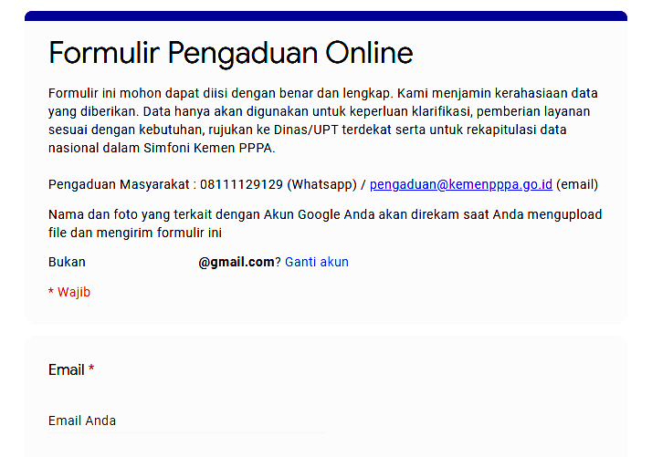
Opening a technical service unit in each province or city
Current
initiative
The data is not synchronized with national data center.
Hotline 1
0821-2575-1234
Create call center / hotline service
to PPPA’s complaint unit
SAPA
129
Hotline 2
0811-1922-911
These phone number is not toll-free yet.
Online Complaint Form
through Google Forms
Looks unconvincing for a government-class institution.
https://bit.ly/kamitetapada
* R E S O U R C E
www.liputan6.com/news/read/4248449/kemen-pppa-sediakan-layanan-pengaduan-bagi-perempuan-dan-anak-yang-alami-kekerasan
Notes:
We discovered that there are 3 methods open for reporting services in the case of woman and child. However, we also found the weaknesses of each method
The first way is they open a technical service unit (unit pelaksana teknis) for woman and child protection in each province or city. (on click 1) That’s good, but each region has its own data, and the data is not synchronized with national data center.
The second one is they create several call center for complaints or reporting services. Recently, they launched the Sahabat Perempuan dan Anak call center 1-2-9, (on click 2) but Mrs. Ciput said that the number was not toll-free yet. Nowadays, many people are also switching from cellular balance to internet quota.
The last method is they set up an online complaint form. But instead of developing their own platform, they make it on an open platform like Google Forms. For the government-class institution, this method is so lack of security and looks unconvincing.

Slide 6
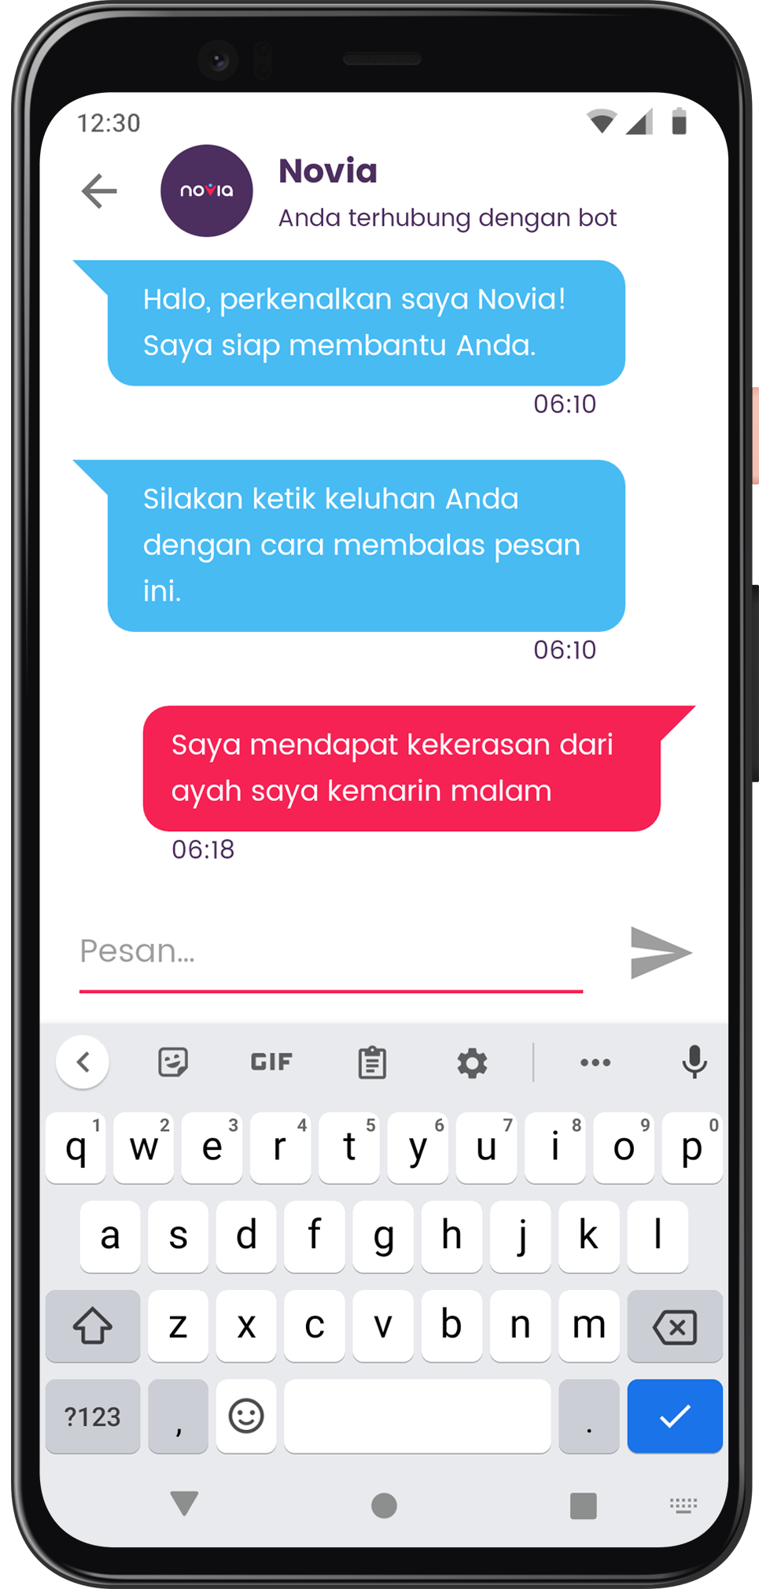
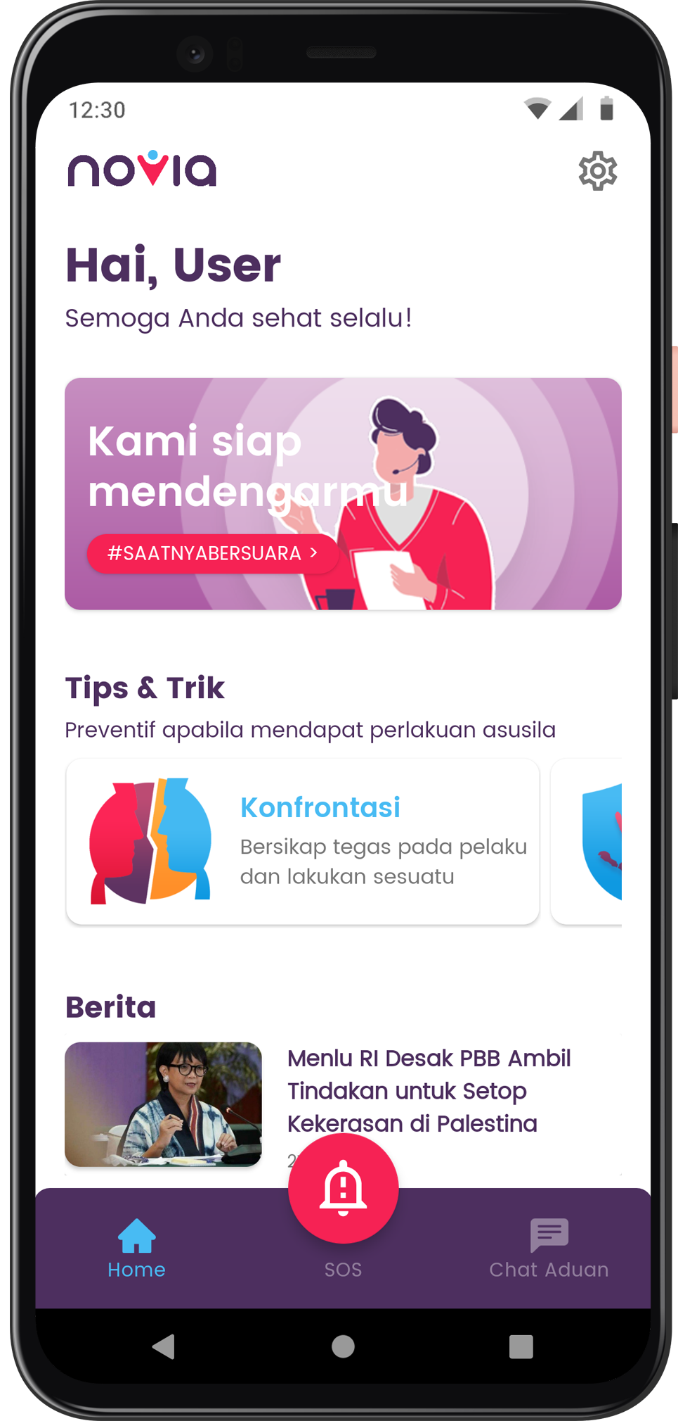

A friendly
reporting app
for any inappropriate acts to woman & child using chatbot.
no-violence app
Notes:
So with this background, we came up with Novia, which stands for no-violence app. (on click) We create a special app for woman and child to report violence, harassment, or any immoral cases in a chatbot format to make the reporting services more interactive.

Slide 7

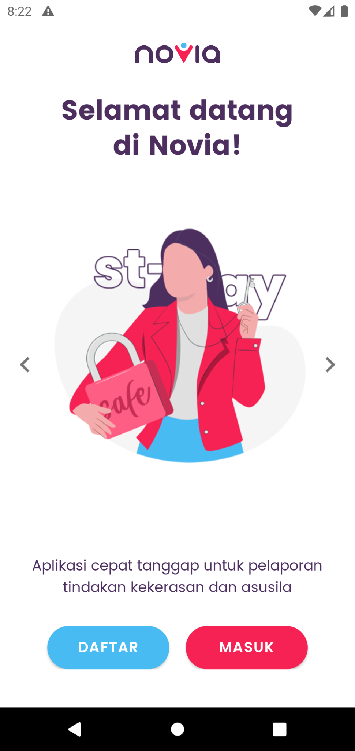

Our goals
faster
way to report
smarter
simplify
system to prioritize
bureaucracy
Notes:
Our goals for creating this project are to make faster way to report, smarter system to prioritize and simplify bureaucracy.

Slide 8
Machine Learning
The dataset.
500
data reports from Google Q&A and journal trained
CATEGORY
USER REPORT
PRIORITY
Dataset can be accessed at
https://github.com/Novia-No-Violence-App-Report/Novia-Model/blob/master/data_nlp.csv
Notes:
We also implement machine learning to create classification of the report. The dataset containing 500 reports which the sentiment column is manually filled in based on the level of urgency. After that we classify the priority of the report whether it’s High or Low.

Slide 9
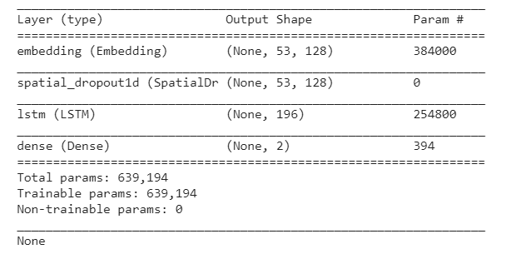

Machine Learning
Using LSTM
for the model
The model takes a report, process, and classify it based on the urgency.
Notes:
LSTM (long-short term memory) is a type of RNN network that can grasp long term dependence. For this project we use LSTM architecture with SpatialDropout1D to build the model so we can make the classification more accurate and faster

Slide 10
Machine Learning
The result?
Train accuracy
92%
Validation accuracy
82%
Loss
24%
Validation loss
64%
It can still be improved with more various data.
Notes:
For this project the result of our model is having 92% Train Accuracy with Validation Accuracy = 82% and for the loss still 24% with Validation Loss = 64%. It can still be improved with more various data.

Slide 11
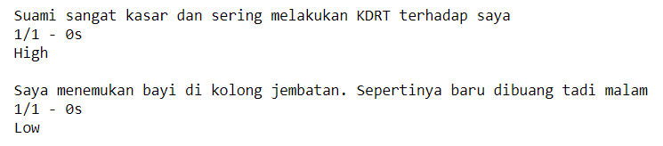
Machine Learning
The testing
Notes:
But the model can detect some words and this is the result of the test

Slide 12


Android App
Implementation summary
1
Using Android Architecture Components
MVVM, Room, repository, and remote & local data source
2
Implementing Clean Architecture
with Koin service locator
3
Other libraries
Retrofit, Firebase Auth, Glide, Material Design
Notes:
Next, is the implementation summary of Novia android app
Firstly, it’s made using Android Architecture Components, which includes views, viewmodels, models, repository, and datasource whether its local using room, or remote datasource from NoviaAPI).
And then, it implements Clean Architecture and Separation of Concerns, with the help of Koin service locator.
And there are some libraries used in Novia app such as Retrofit, Firebase Authentication, Glide, Material Design, and many more.

Slide 13
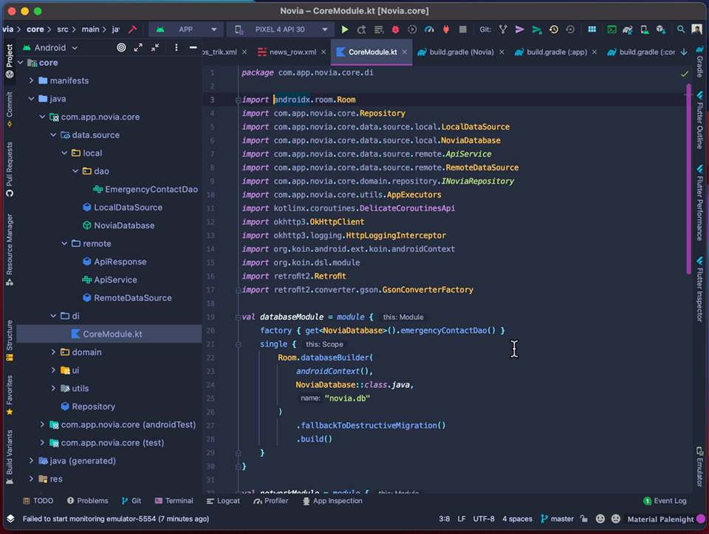
Android App
Modules
Notes:
There are three main modules in this app, including database module, which is handling local database transactions
Networkmodule, which is using retrofit, enabling API request to Novia API
And the last is repository module which is the center of data transaction in Novia App.

Slide 14
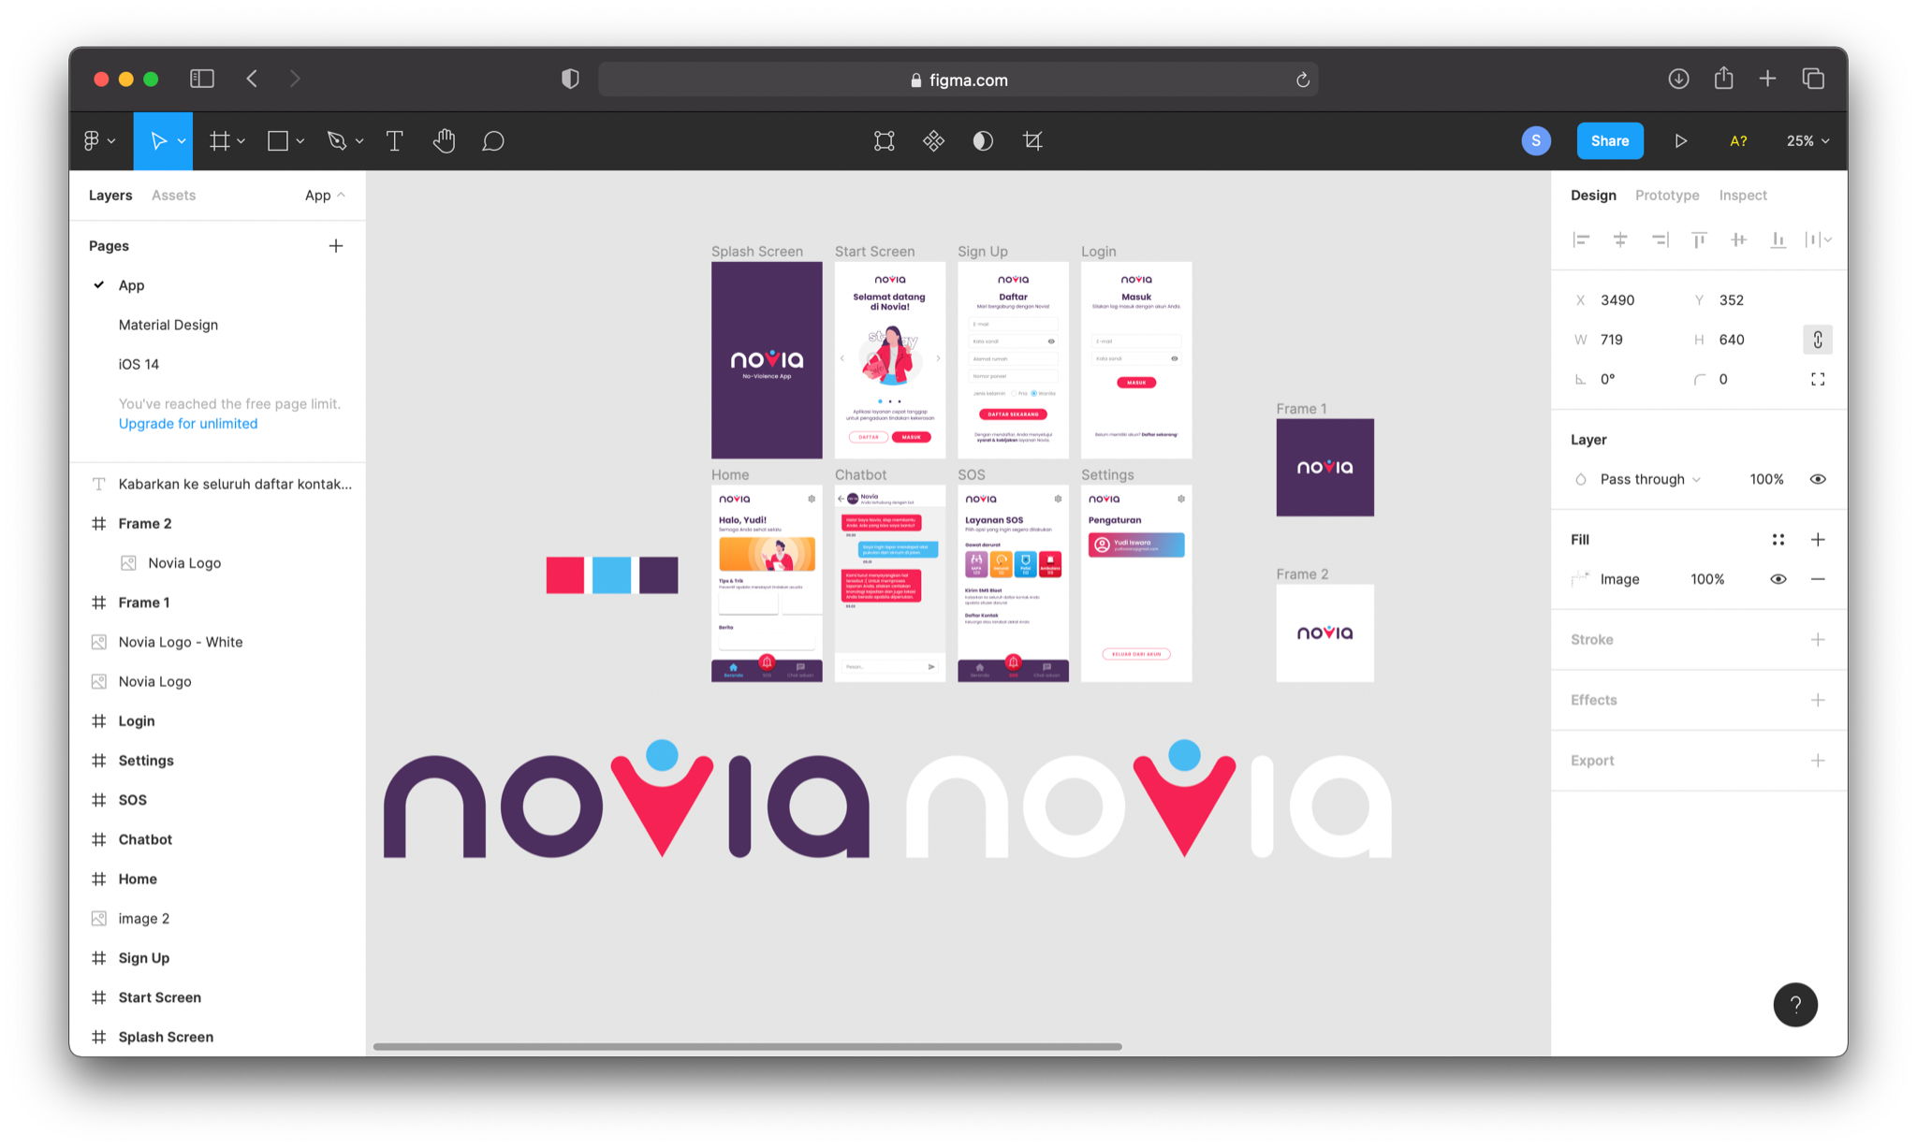








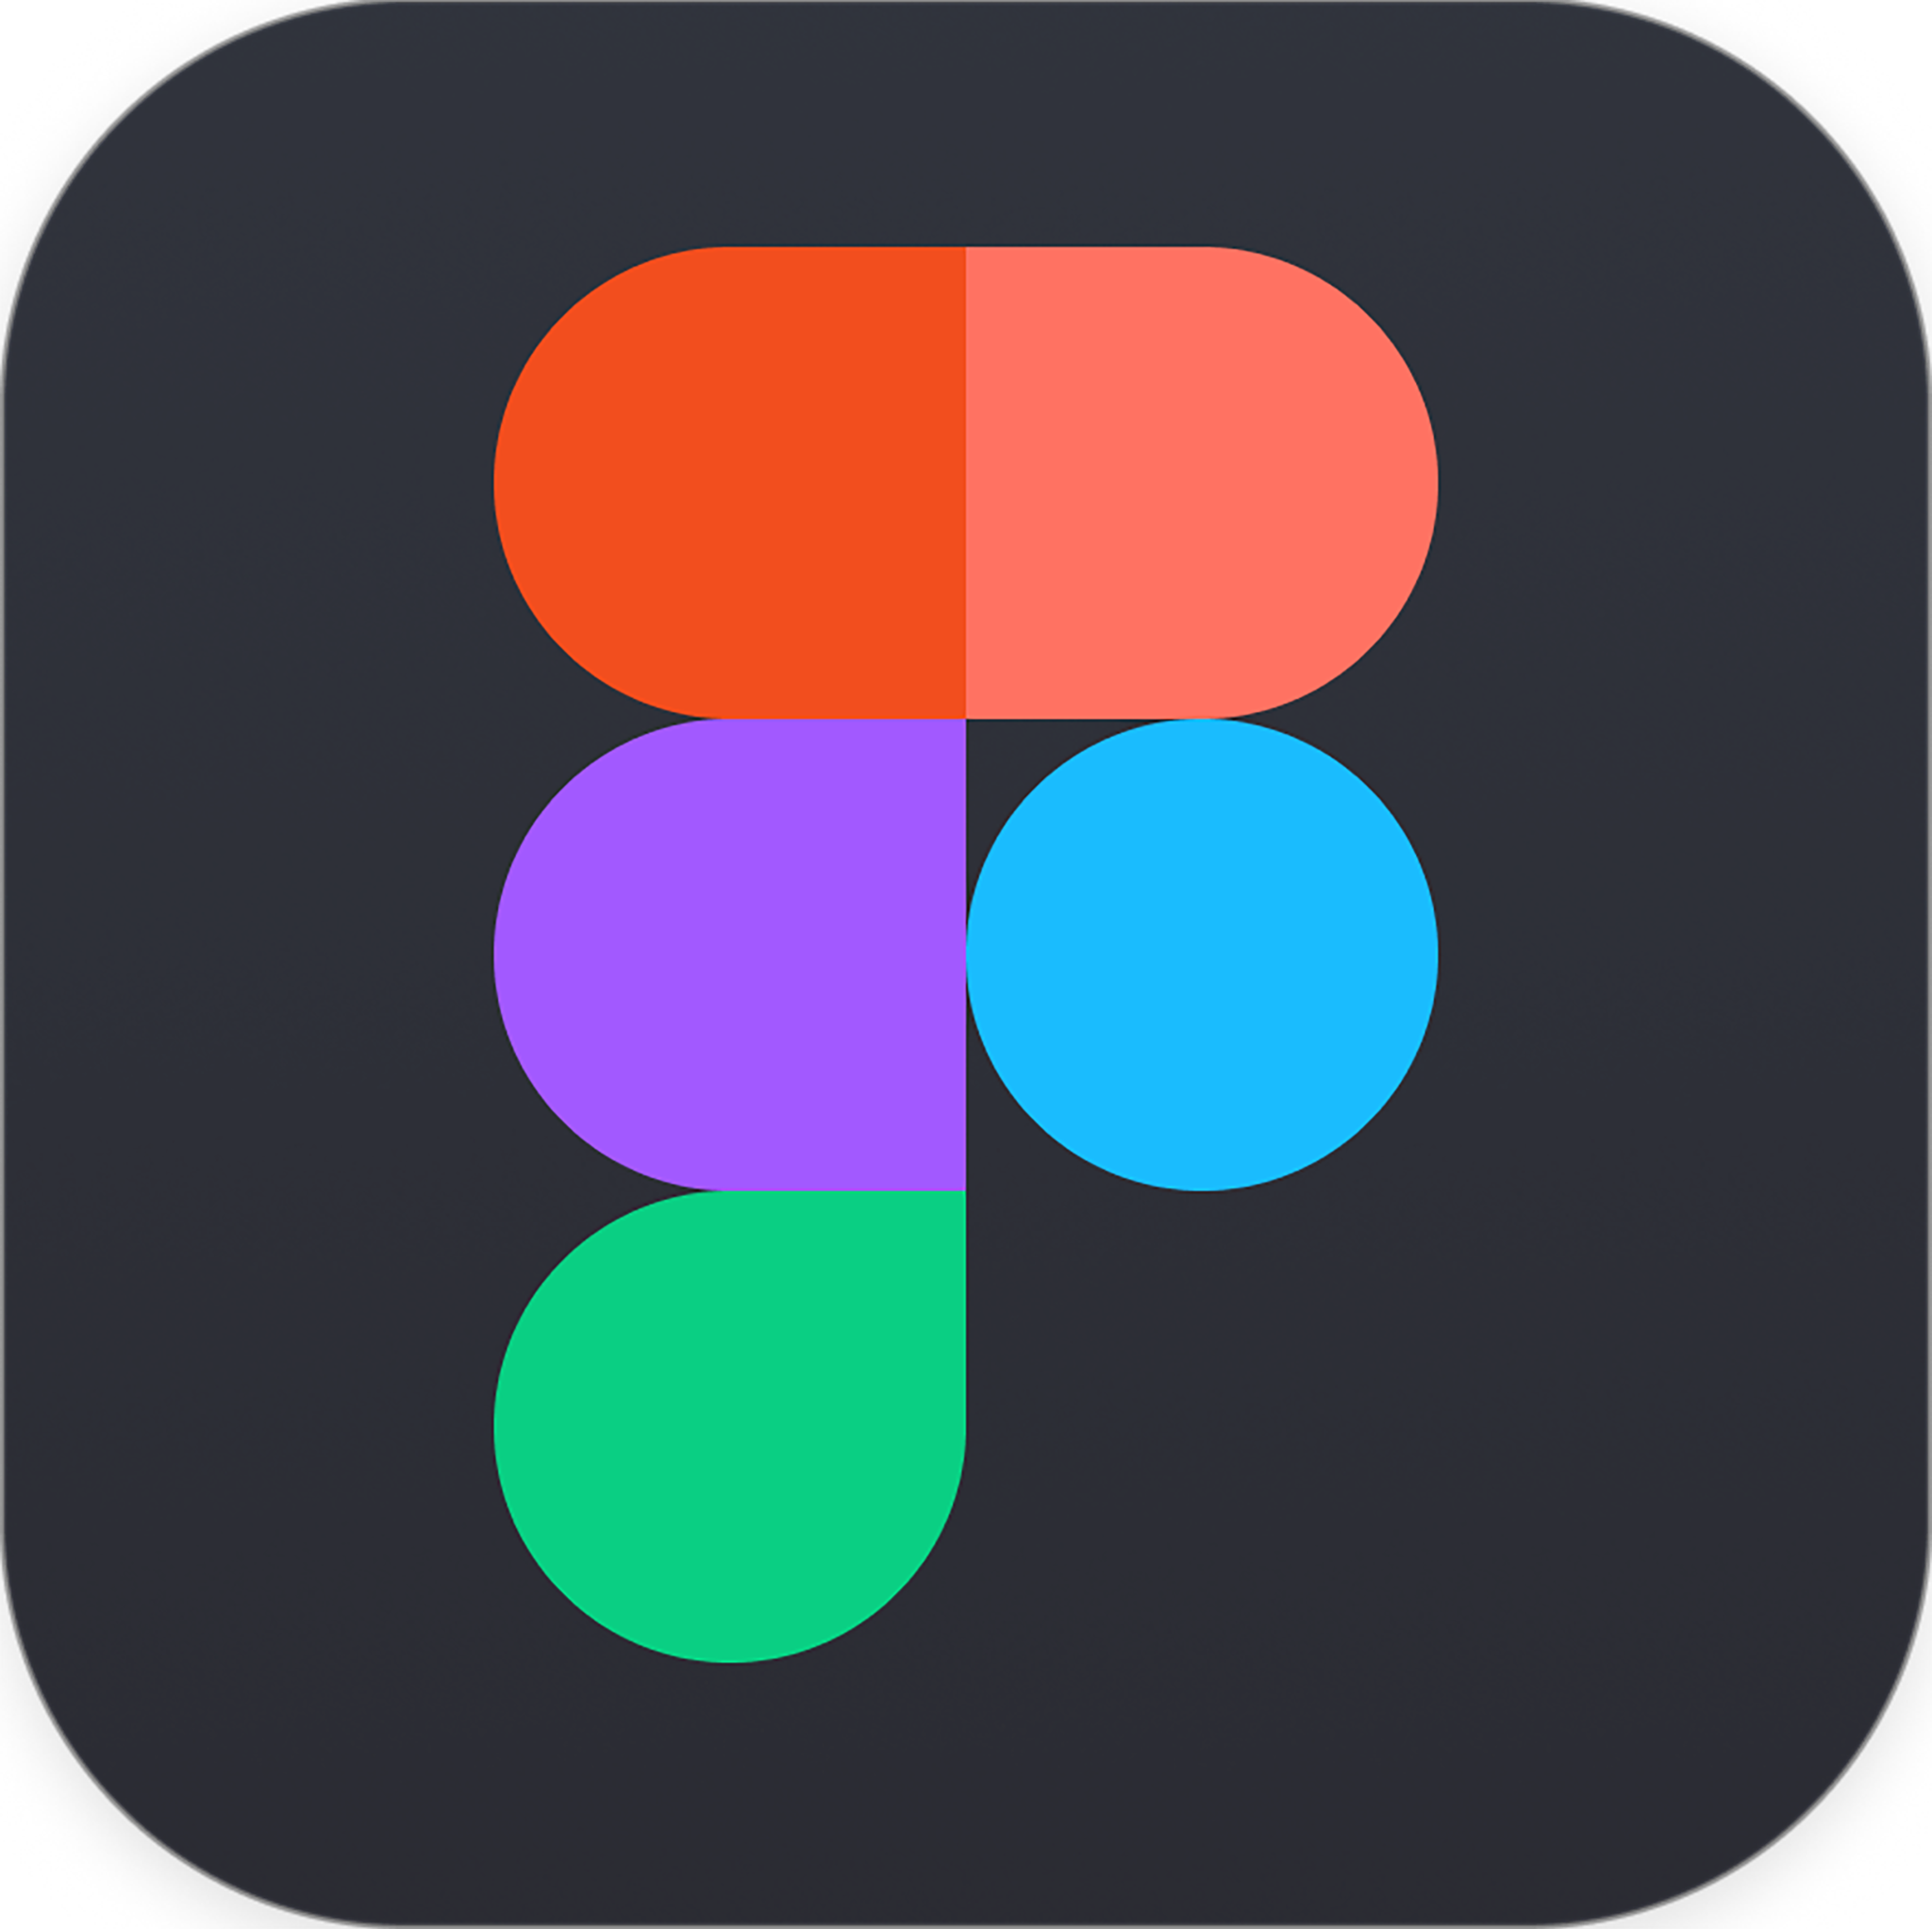

Android App
User Experience Design
Design
what
matters.
Created with
Notes:
We also concern to the content that will be brought to the user. Starting from scratch, we designed several colors, icons, illustrations, and even prototype. We determine what features are important and needed by users when they want to report a case, or in the emergency situation.

Slide 15
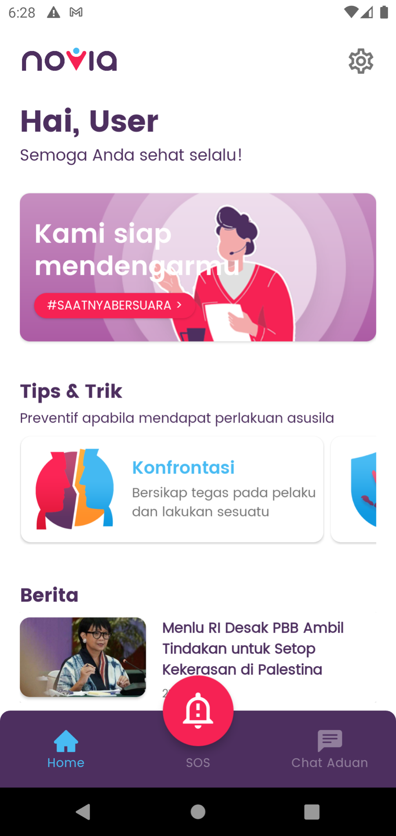
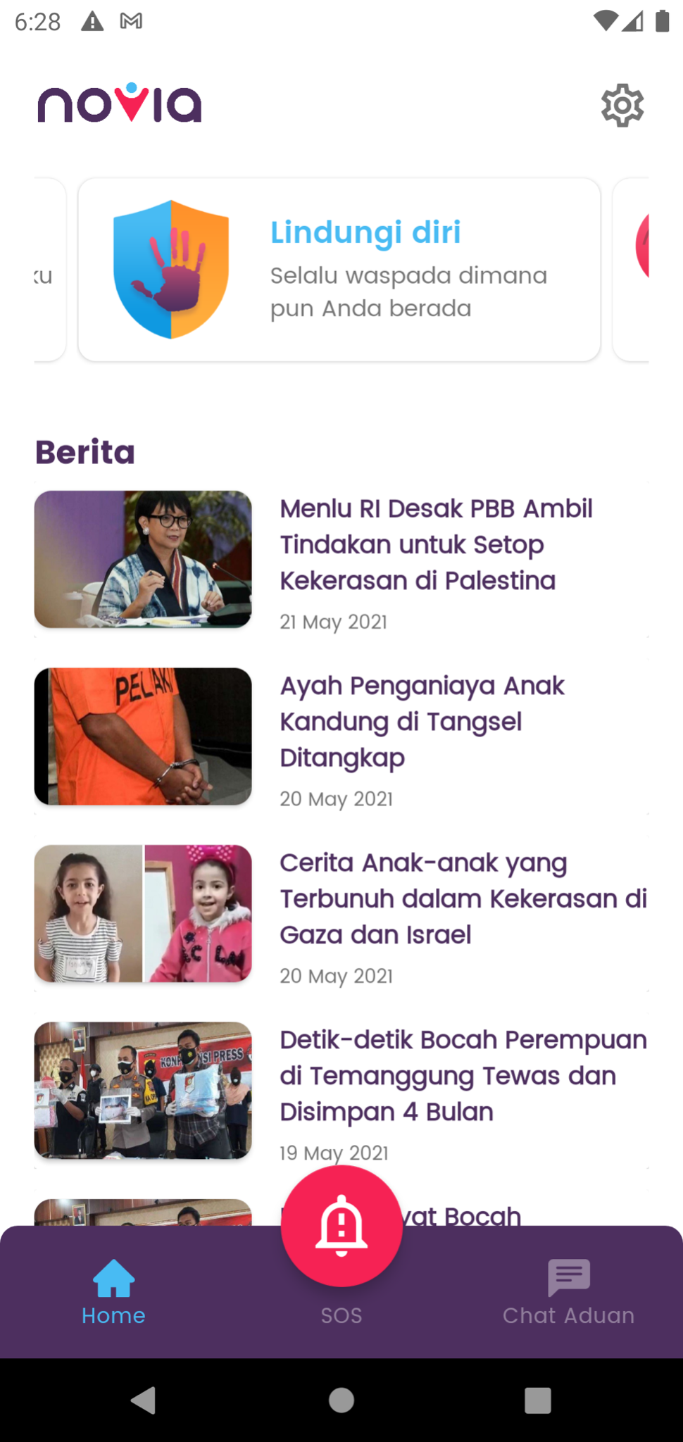
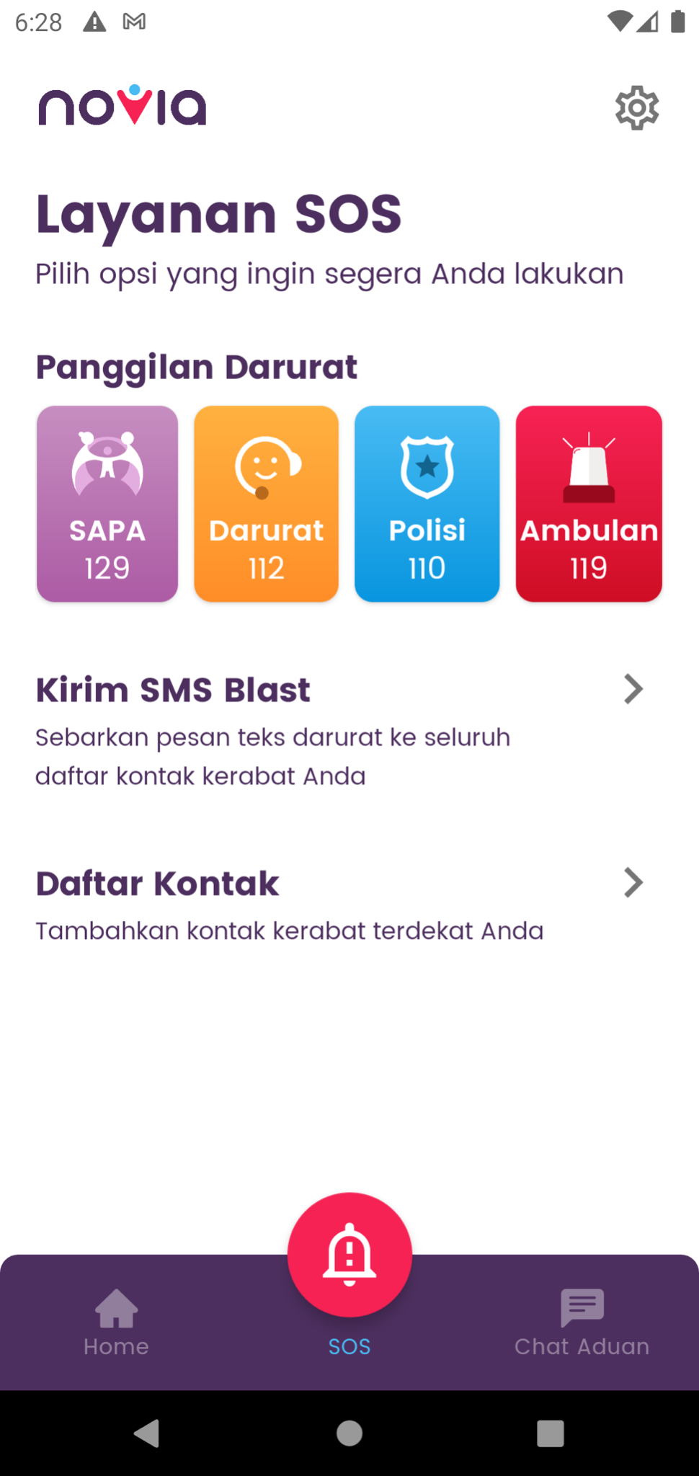
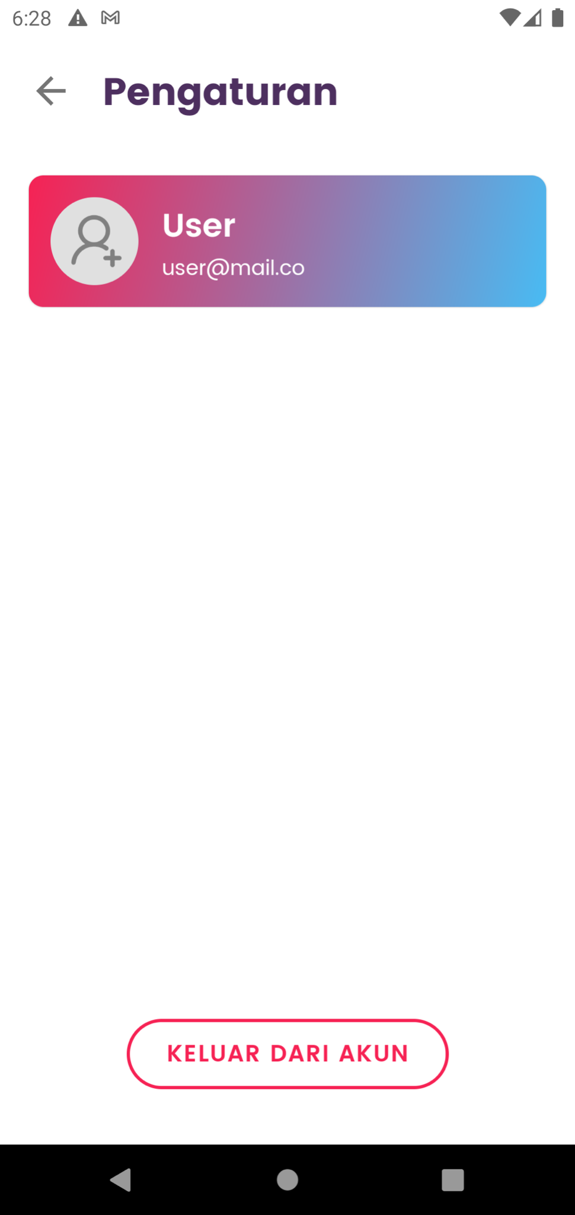
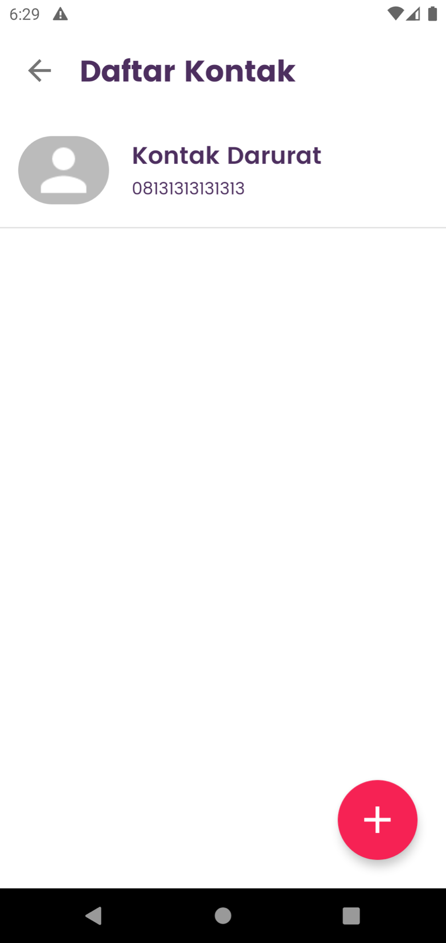
screenshots
Notes:
These are some screenshots sample of the Novia app on Android phone. Here are Home activity on the middle side, Settings menu on the left, and SOS feature on the right. We will explain further in the demo section.

Slide 16
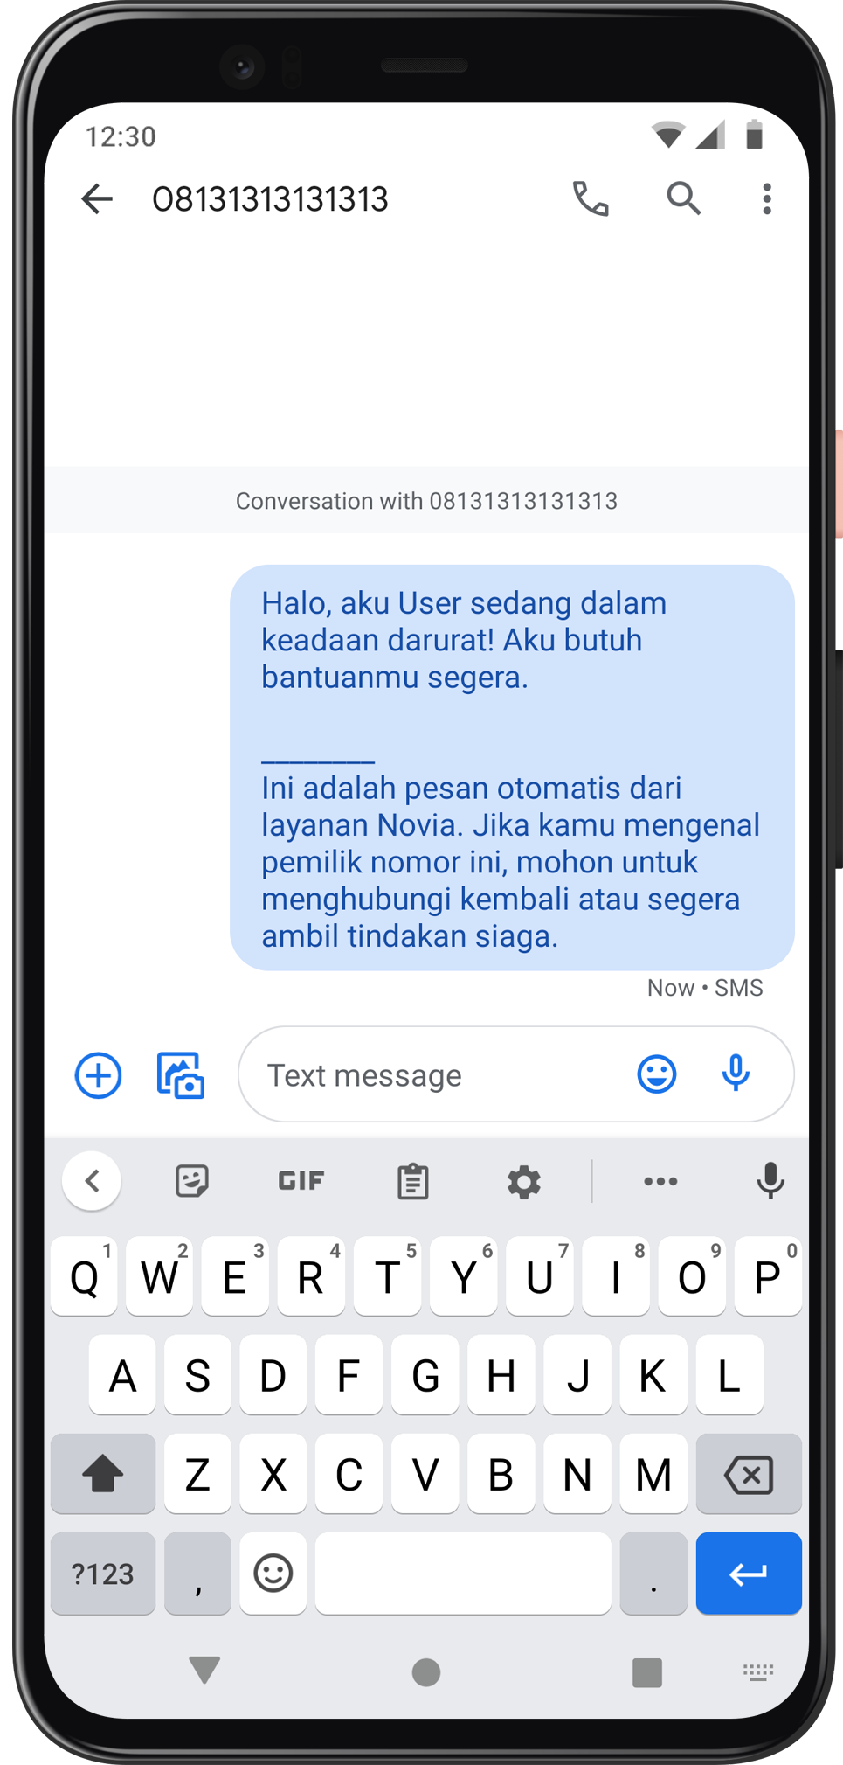
Add report using chatbot
Get recent news articles about
women and children in Indonesia
Add any relative contact
for the emergency
Send SOS text message
to your emergency contact
SOS!
Call national emergency agencies
SAPA 129
Sahabat Perempuan
dan Anak
112
Emergency
Portal
110
Police
Call Center
119
Health
Center
features
Notes:
Novia app let you send reports using the chatbot section, add your relative's contacts, and text them simultaneously with the automated message in case the user is in an emergency. We also provide additional features such as daily news about women and children in Indonesia to keep the user stay informed, and to call several national emergency hotlines which are also related to preventing inappropriate actions against women and children.

Slide 17




Cloud Computing
Services
1
2
3
4
Virtual Machine
Google Compute Engine
Storage
Cloud Storage
Database
Cloud Firestore
Web API
Node JS
Notes:
After we created Machine Learning Model and Mobile Application, it’s time to deploy the application. We use 3 Google Cloud Platform services, Google Compute Engine, Cloud Storage, and Cloud Firestore. We use Node.js for REST API. For predicting data from Android, We use tensorflow js in Node js

Slide 18



Cloud Computing
REST API
1
2
3
Get Report Data
from Android chatbot, predicting the importance, and storing it into Firestore Database
Add User Data
to Firestore after user successfully registered with Firebase Authentication
in Android
Get News Data
from News API and passing the data
to Novia’s Android application
News API source:
https://newsapi.org
Notes:
There are 3 main things in our REST API. Get Report Data from Android Chatbot, Add User Data to firestore, and Get News Data from News API using API KEY.

Slide 19
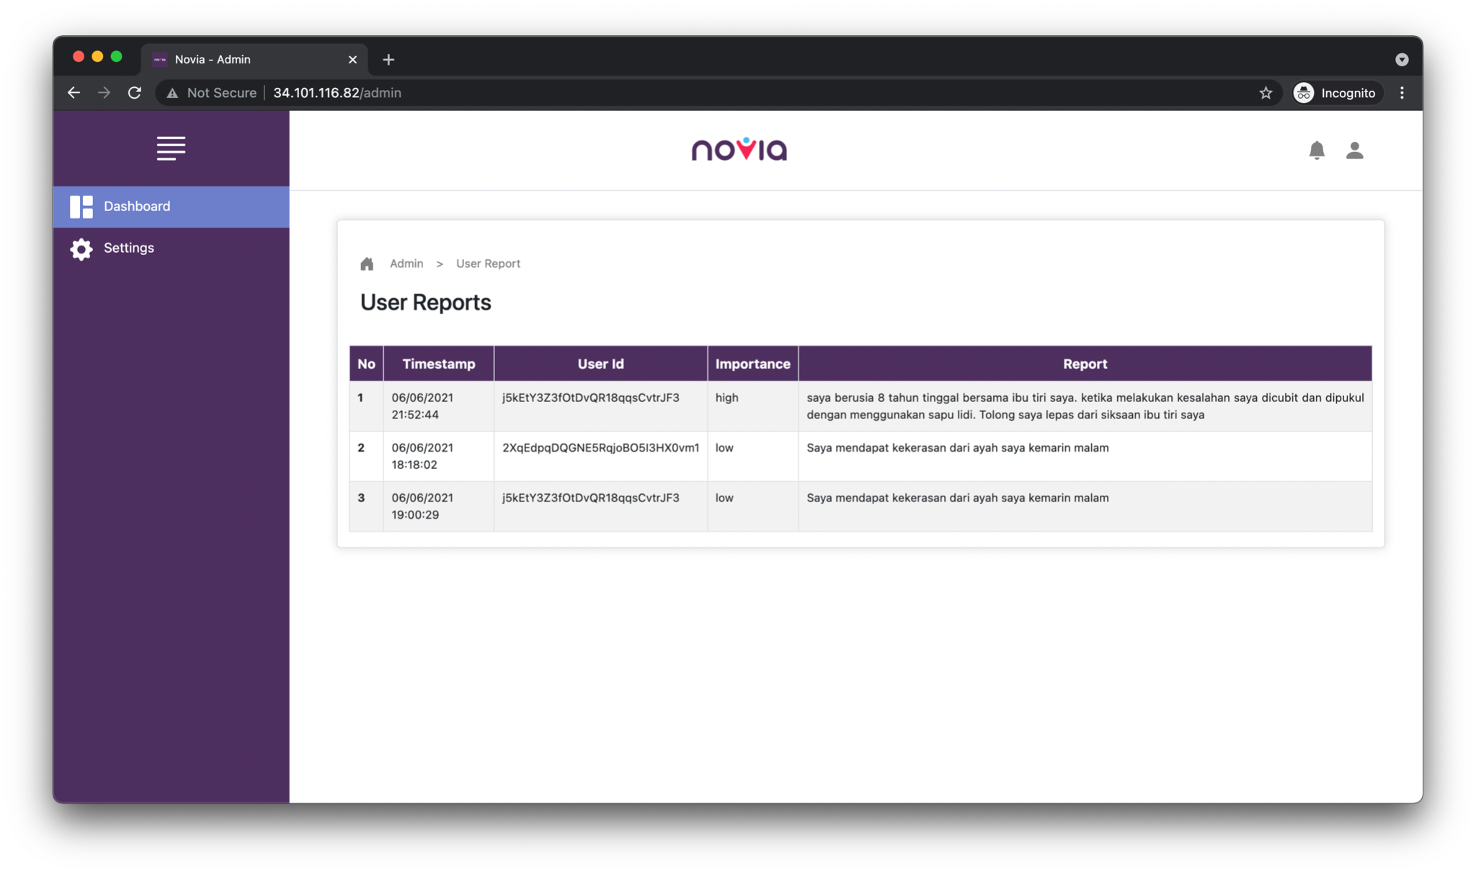
Administrator
website
Display
user reports
database.
Administrator website can be accessed at:
http://34.101.116.82/admin
Notes:
This is the administrator's website. This website displays user reports database. For the website UI, we use Bootstrap framework.

Slide 20

Application
demo
Documentation can be accessed at:
https://github.com/Novia-No-Violence-App-Report/app-novia
Notes:
Lets see the demonstration of novia app
This is the welcoming screen
This is the registration page,
And of course user can sign in using email and password
This is the home screen of novia app, which contains greetings, tips and tricks, and news about women and children
We can also display the news details and visit the webpage of the news
And this is the settings page that displays user info
Next is SOS service. Firstly there are some contacts for national emergency agencies. And also there is a emergency contact list which we can add and edit.
And we can send SOS message to our emergency contacts
Our main feature is chatbot. User can write their reports, and the report will automatically send and classified using Novia API

Slide 21



Business Model
The partner-centric
business
Potential partners:
Sell the app and technology license or holding a
strategic partnership
to the official authorities that
responsible for the issue of women
and children protection.
Notes:
Finally, we’ve come to the end of the presentation which is about the business model. We believe that our idea can have a better impact on reporting services in the future. But we know that we cannot stand alone, so with a partner-centric business approach, we hope to find the best partners so that the Novia app may be impactful for more people. So as a contribution to the nation, we open a scheme for cooperation with the partners who are most responsible for this issue, which are the government and its supporting authorities.

Slide 22




Capstone
Project
Thank you!
Group ID
B21-CAP0213
Notes:
And that’s a wrap! Thank you for your time and attention. See you in the future!

Slide 23



Cloud Computing
Get Report Diagram
Google Cloud Platform
Novia ML Model
Cloud Storage
Phone
novia-production
Compute Engine
Phone
Cloud Firestore
Desktop
Notes:
This is the diagram about how to get the report data from the android chatbot.

Slide 24


Cloud Computing
Add User Diagram
Firebase
Phone
App Server
Notes:
This is an add user diagram. We use firebase for user authentication. Then, all of the data will be stored in firestore.

Slide 25
Cloud Computing
Get News Diagram
Google Cloud Platform
novia-production
Compute Engine
Phone
News API
News API source:
https://newsapi.org
Notes:
and the last is the diagram about how to get news from news API. News data is obtained from the news API. Get API key from the News API Website and put the API key into REST API running in Google Compute Engine.

Slide 26



Our challenges
Machine Learning
• NLP techniques & methods
• Datasets
1
Android & Cloud
• How to integrate the ML model?
• How to build the API?
2
Other
• Each of us have unfinished tasks/courses in Bangkit
• Limited amount of time
3

Slide 27




Android App
Priority list
1
2
3
4
Functional
chatbot (MVP)
Tips/Trick & News
feature
SOS
feature
User
authentication

Slide 28



Machine Learning
Priority list
1
2
3
Effective ML Model
Suitable hyperparameter
Efficient ML algorithm

Slide 29


Cloud Computing
Priority list
1
2
3
API
Development
Building infrastructure for Machine Learning
Deployment using
Cloud Function

Slide 30
Short introductions and expectation setting [15 min]
Novia, a violence reporting app, especially for children and women
Using ML-based chatbot as the reporting method

Slide 31
Team Challenges[50 Min]
ML
NLP techniques & methods
Dataset
Android & Cloud
How to integrate ML model to android app? Use API?
How to build the API, any recommendation for tech stack?
Other challenges:
Each of us have so many unfinished tasks or courses in Bangkit, so we can’t focus working in the capstone project
Limited amount of time

Slide 32
Action Item & Next Steps [15 mins]
Android priority list:
Functional chatbot (MVP)
Tips & tricks and news
User authentication
SOS feature

Slide 33
Action Item & Next Steps [15 mins]
Cloud Computing priority list:
API Development
Building Infrastructure for Machine Learning Model
Deployment using Cloud Function

